Slide 1
Progress Log
CYBER CAPSTONE
Learn Cybersecurity: “Lexi’s Cyber Club”
MAY 2025
Notes:
Add photo of Carson

Slide 2
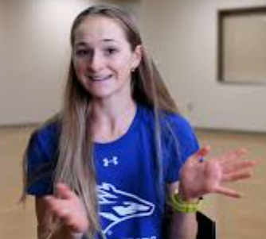
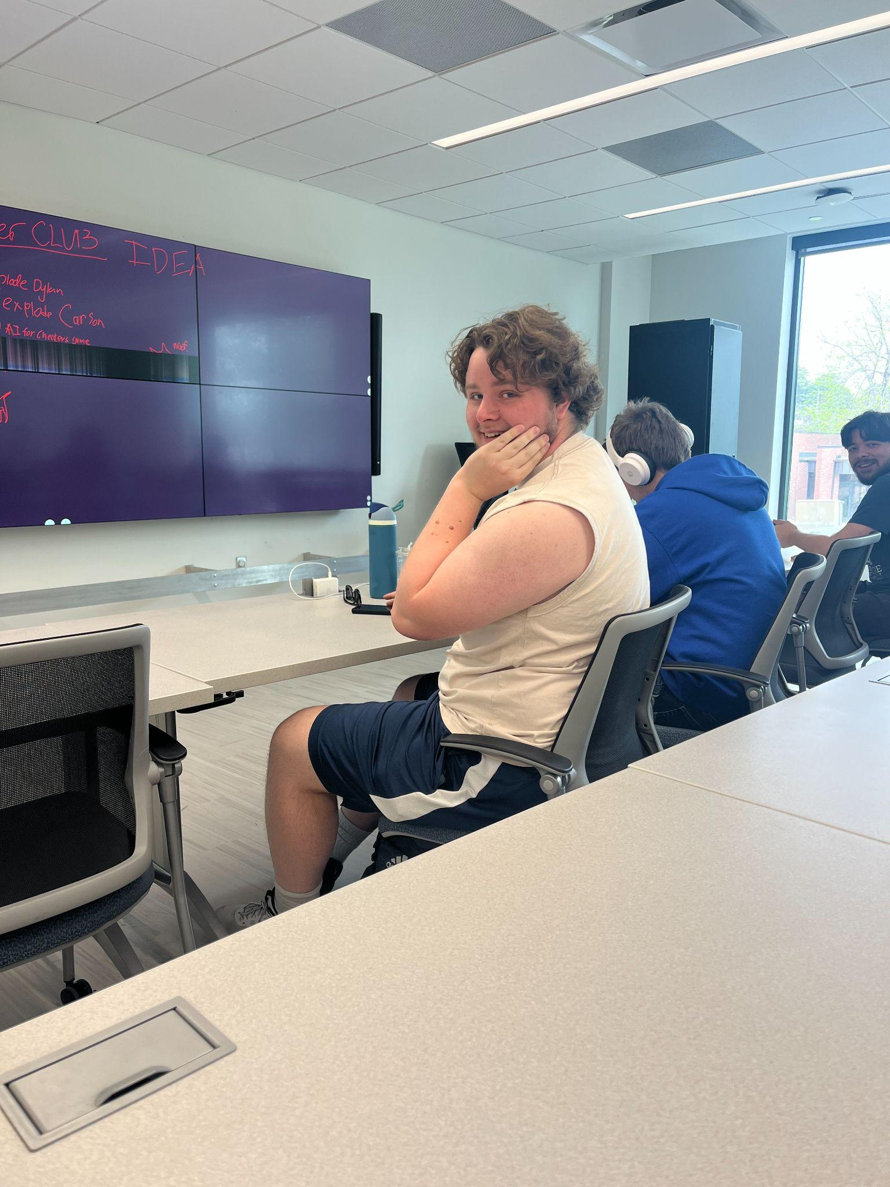
Introduction
Project Title
Introduction of all team members
My Inspiration:
Lexi’s Cyber
Club. The place to learn personal cybersecurity 👍
CARSON
“TA-DA!”
This is where I am documenting the progress made on the Learn Cybersecurity platform.
Notes:
Include a photo of Carson in the introduction (100).

Slide 3
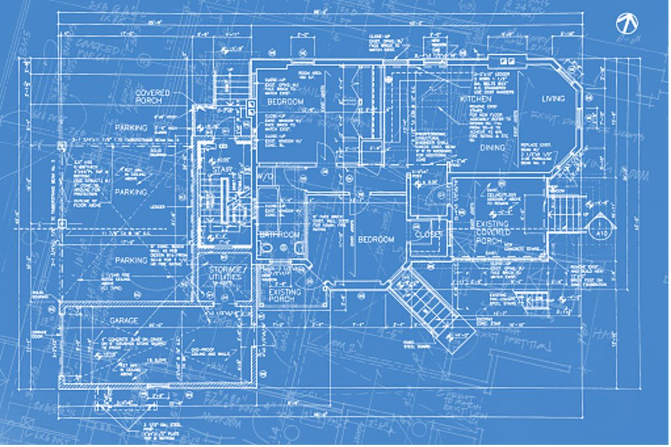
Statement of Work (SoW)
Plotting out what will need to be done (think of this as a blueprint)
Project Objectives and Deliverables: Full-Stack Web Development. Stores data. Learning modules.
✅
What are the most important features (1) Having a website up and working (2) Having content on the website
✅
Notes:
Comprehensive description of project goals and objectives (4)
Clear definition of project scope (3)
Well-articulated deliverables (3)

Slide 4
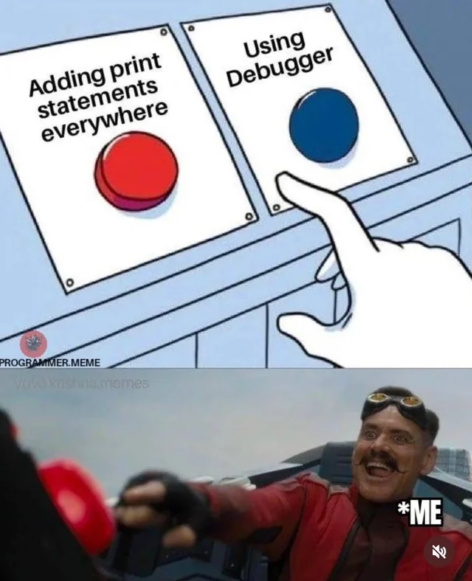
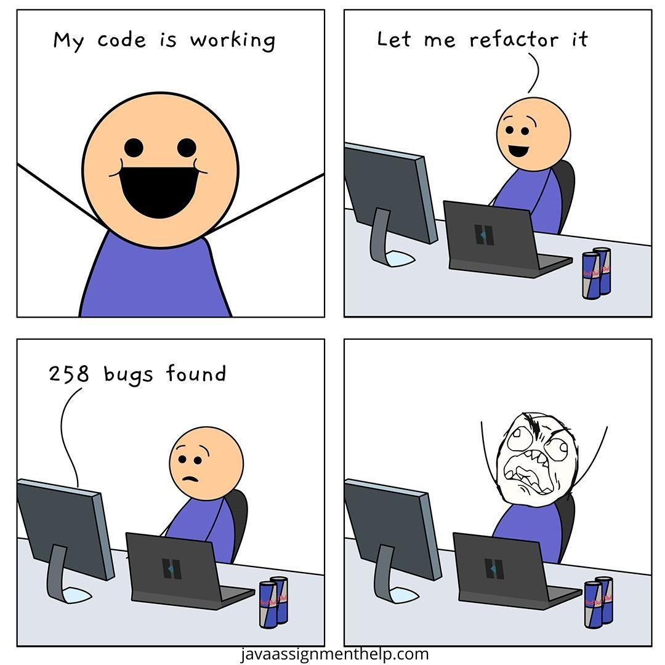
SOW Development Process
Full-Stack Web Development.
Program, design, research online, redo
Iterative Process
Data Storage
Deliverables .
Research, find tools, write, create a game, maybe create a video
Learning Modules
Notes:
SOW Development Process
Detailed explanation of the iterative process used to develop the SOW (5)
Discussion of how SOW planning influenced implementation (5)

Slide 5
Front-end
(JavaScript React)
Front-end
System Design (UI/UX, Database, API [request and response])
OVERALL SDLC FLOWCHART
Full-Stack
Web Dev
Website /
Web Application
Gathering Requirements and Analysis
Testing, Deployment, Maintenance and Testing
Back-end
Back-end
(Node JS)
AGILE
Notes:
Overall SDLC Flowchart
Comprehensive project flow chart showing SDLC (4)
Logical design clearly representing project workflow (3)
Professional visual presentation matching slide deck style (3)

Slide 6
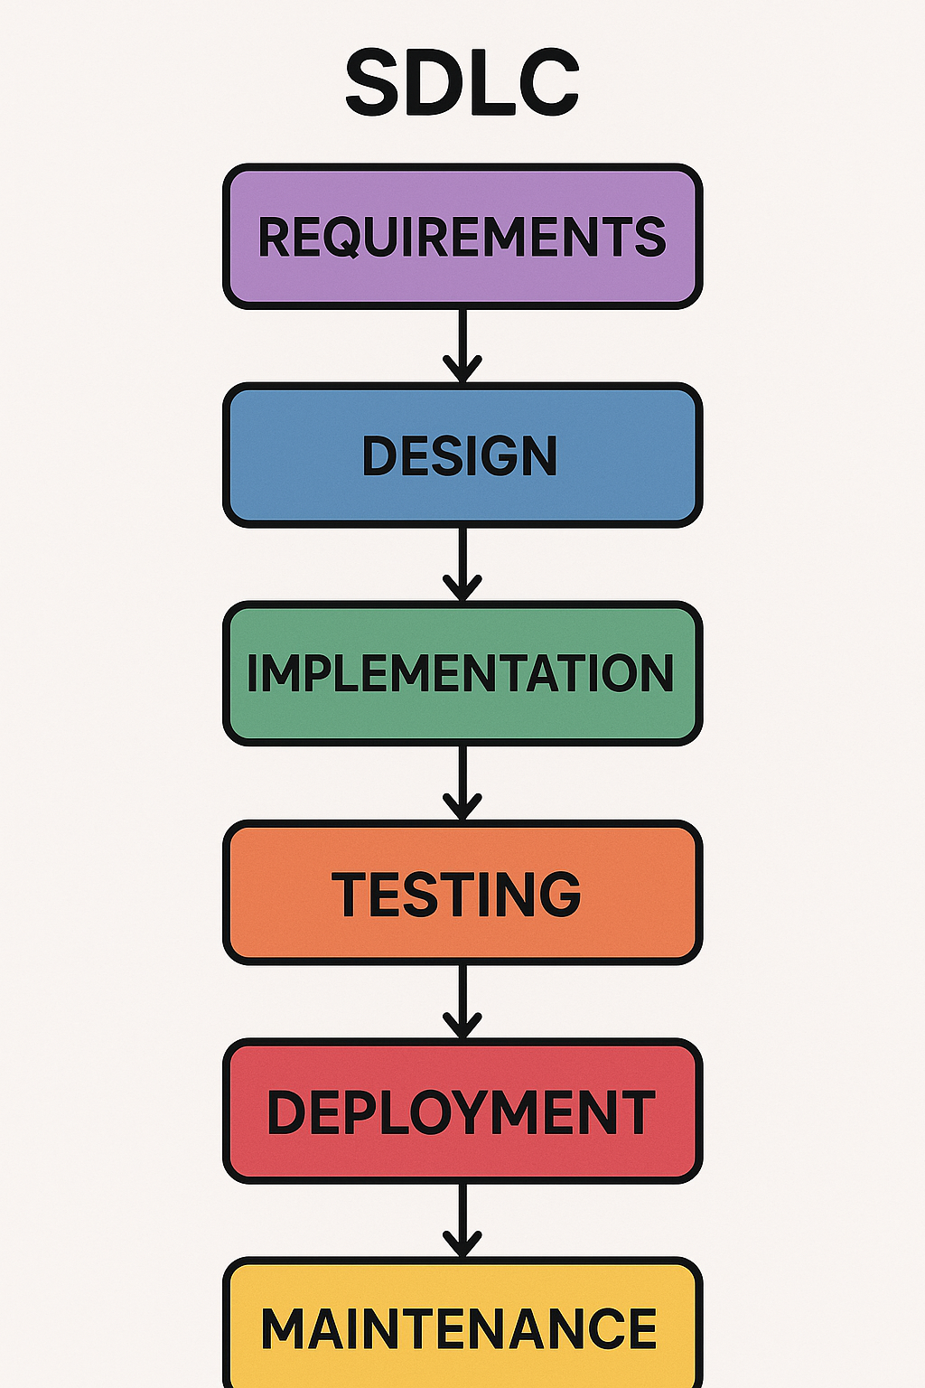
Information Architecture
REACT
The organization of information.
Full Stack = (Front-end + Back-end) + [OTHER]
WBS/Information Architecture
JAVASCRIPT & CSS
MONGO DB
FULL STACK WEB DEVELOPMENT
NODE JS
SQLite
Notes:
WBS/Information Architecture
Detailed Work Breakdown Structure or Information Architecture diagram (5)
Clear readability and professional presentation matching slide deck (5)

Slide 7
Deliverables Demo
CARSON says “go fast”
Learn Cybersecurity: “Lexi’s Cyber Club”
Notes:
Add photo of Carson

Slide 8
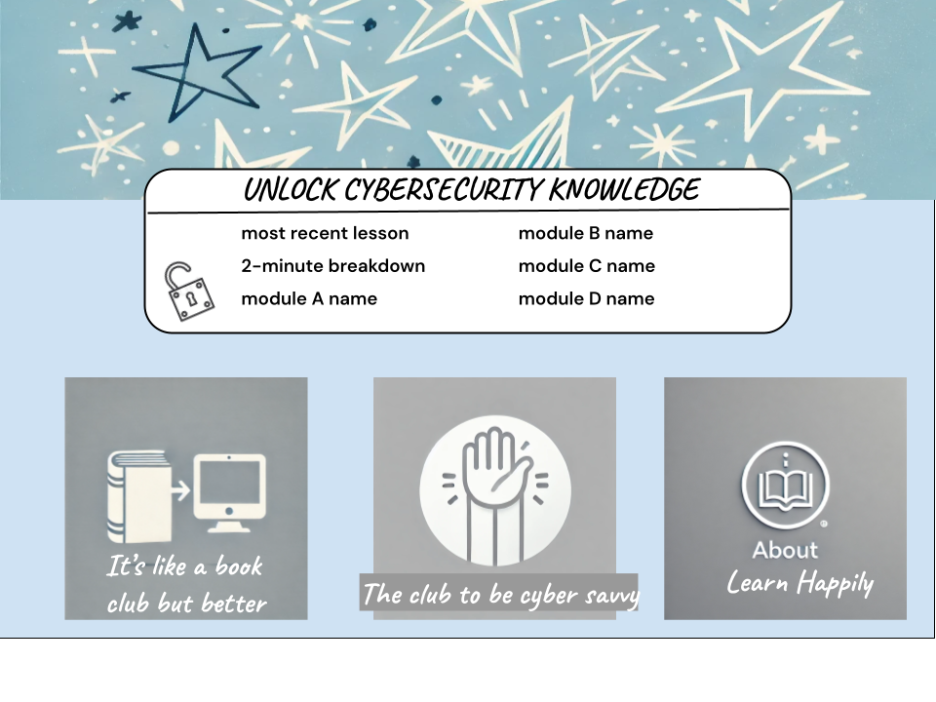
Initial Design
This is the initial design
Done in Google Draw

Slide 9
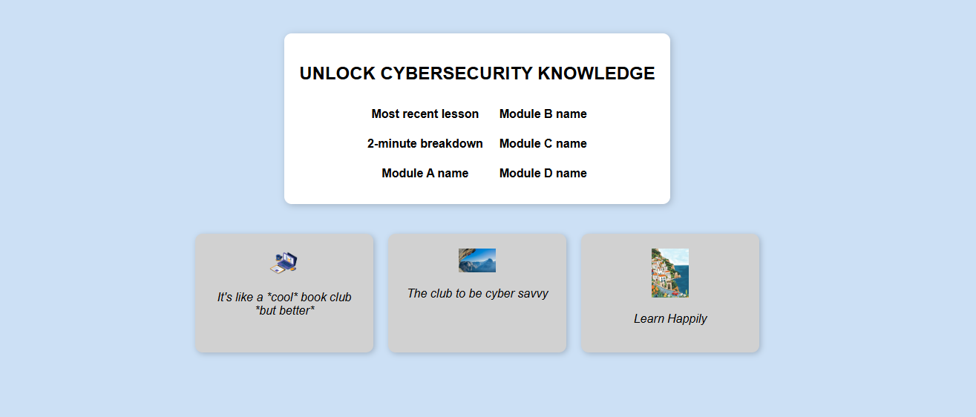
Version 1:
“The Bones”
This is the outline of a MVP
Done (WITHOUT CONTENT) on 2/7/25
Runs on GitHub pages
These are clickable
SUBHEAD
DATE

Slide 10
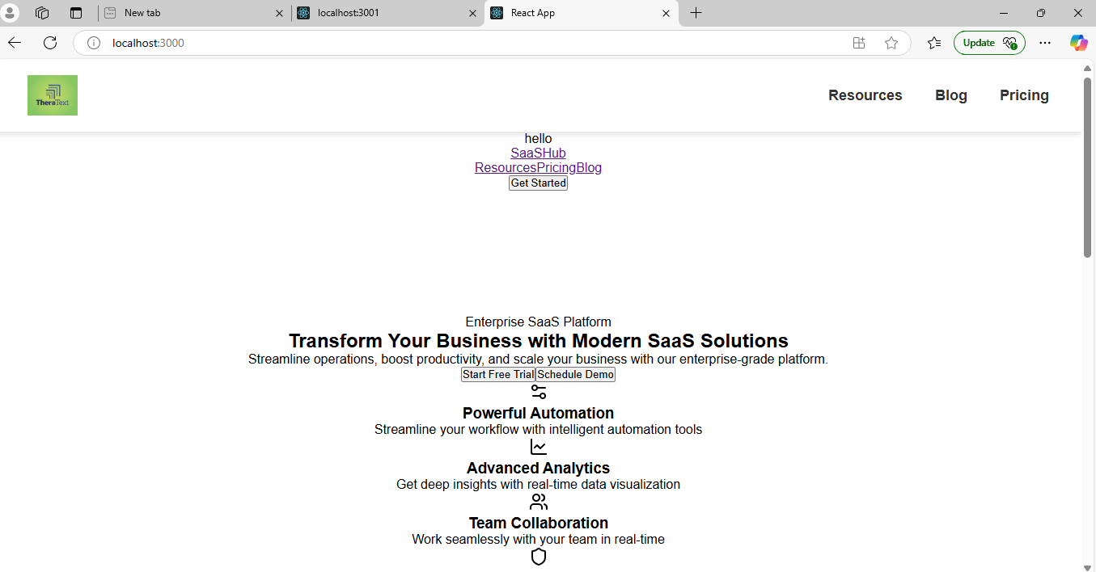
Version 2:
“Getting a REACT-tion”
This is 1st step of connecting back-end and front-end
Done (WITH FILLER CONTENT) on 2/14/25
SUBHEAD
These are clickable
DATE

Slide 11
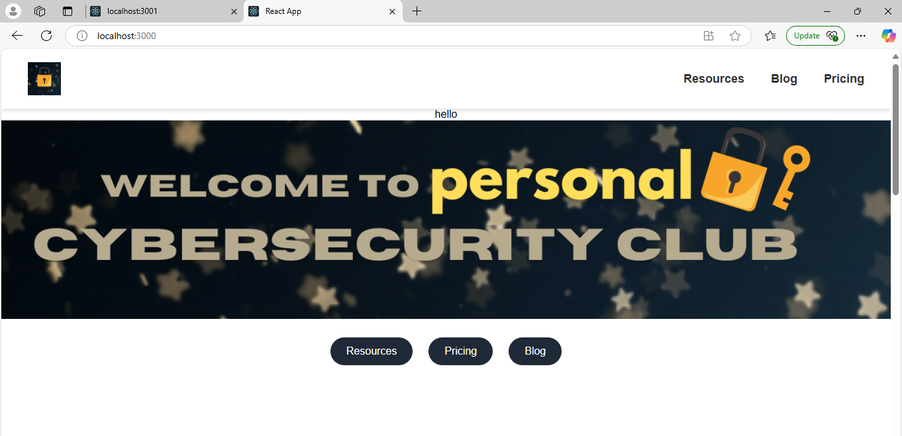
Version 3:
“Front-end Buttons”
Done (WITH FILLER CONTENT) on 2/18/25
SUBHEAD
These are clickable
DATE

Slide 12
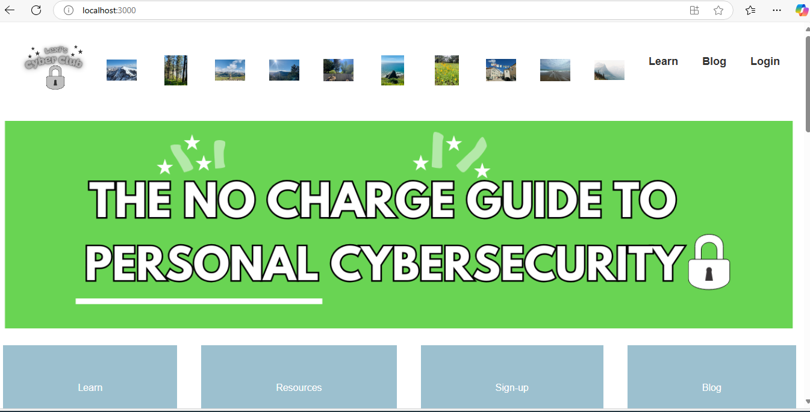
Version 4:
“Front-end Work”
Connected to Database 3/12/25
SUBHEAD
These are clickable
DATE

Slide 13

Version 5:
“The Detour”
Mid-semester I decide I am going to start all over and follow the styling of the
Sushiman website (3/13/25)
*bad choice*
SUBHEAD
Teaches me that User Experience and look really matters for these types of products - that’s how you keep people coming back
DATE

Slide 14
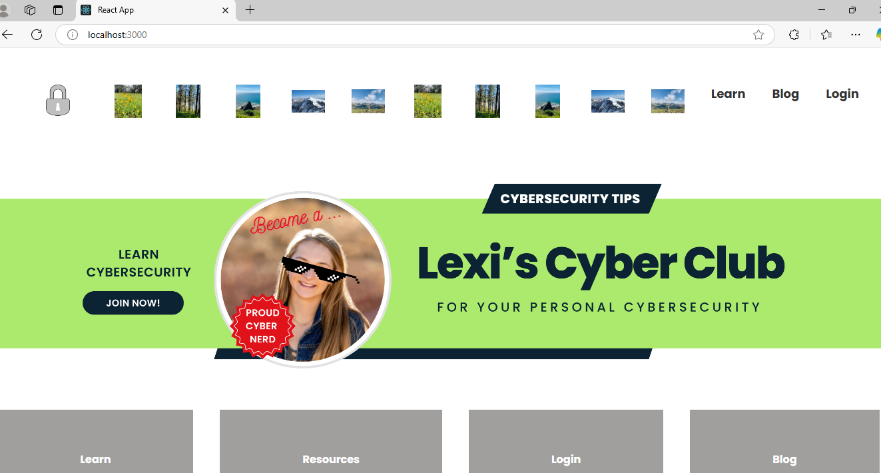
Version 6:
“Redirect”
Presented in-class 4/21/2025
SUBHEAD
DATE

Slide 16

Now the big
*actual*
reveal
We’re on Version 7 now in case you are wondering

Slide 17

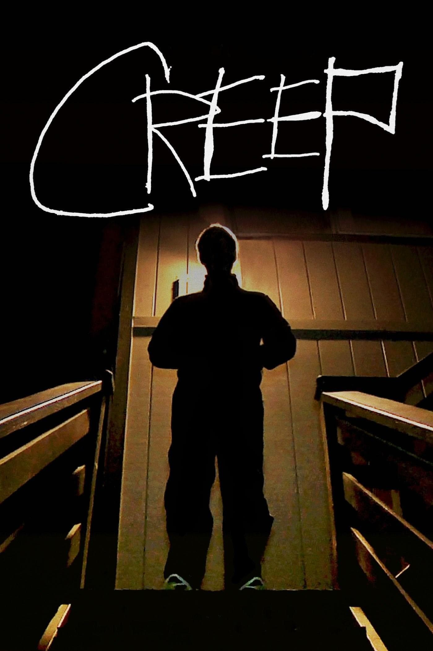


Did I create some (3) learning modules?
Did I do (1) Full-Stack Web Development?
Am I (2) Storing Z data?
✅
Reflection
✅
✅
Did I create as many learning modules as I originally scoped out?
Did I follow Agile Methodology correctly?
Originally wanted (A) A website, (B) Ready for launch, (C) Active online, (D) Something to continue working on.
of scope
NO
Life happens
Notes:
Goal Achievement Reflection
Thoughtful analysis of how final results address the original SOW (4)
Honest assessment of successes and shortcomings (3)

Slide 18
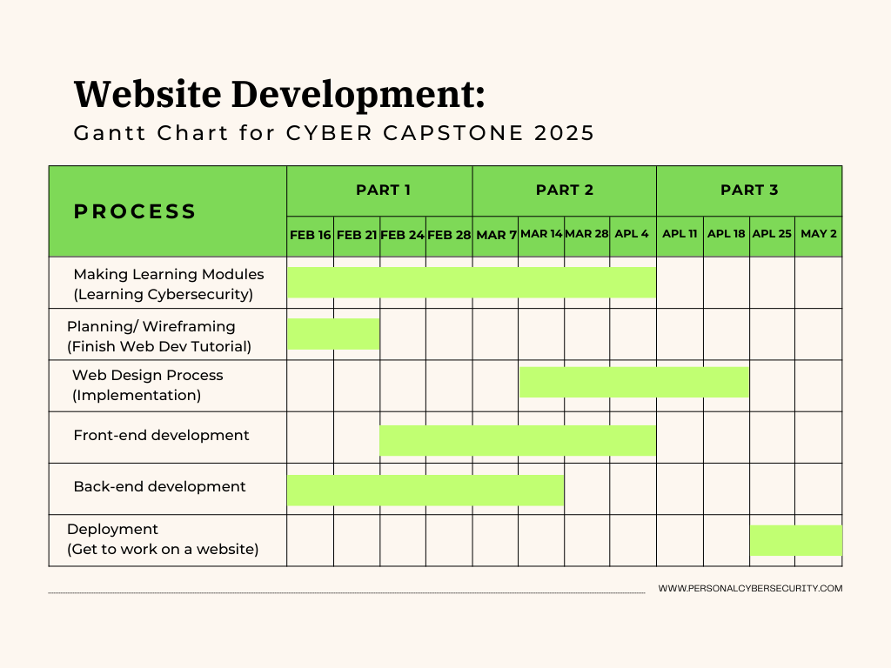

Slide 19
“IRL” Timeline
Feb 16-21
Feb 24-28
Mar 7-14
Mar 28-Apr 4
Apr 8-Apr 26
Apr 27 - May 5
May 5 - 13
Planning, Research
SCHEDULE AND MILESTONES
Back-end mainly (but a bit of everything)
Front-end mainly (but a bit of everything)
Work on the project 😭 RIP COMPUTER
Notes:
Schedule and Milestones
Clear presentation of project timeline and milestones (4)
Detailed work packages with assigned responsibilities (4)

Slide 20

What we did
We have a website!!!!! (thank you to Milk On The Floor)
Two to Three Completed Early Learning Modules
2 Videos
Navigation between pages
Taking in user sign in data
7 Prototype Versions (8 would be great)
What we learned
How to do Full-Stack Web Dev
JavaScript and React
Connecting a back-end
Using AI some to troubleshoot errors (also the debugger and CNTRL F)
Cybersecurity things to help in personal life
Notes:
Project Implementation Slide. I’ve gone through 7 prototypes. 8 would be nice. Eventually I want to get to a point where I can start sharing this with others and hopefully build the platform a bit… maybe this summer.

Slide 21
I am using VSCode as my IDE.
The initial work for this project is successfully done!
We have a website that is developed and still able to be developed. I have access through using React, JavaScript, and SQLite.
Reflection and next steps as of 5/13/2025
Thoughts?
The backend and frontend are in communication.
Another thing is I would like to update the Blog page to look better.
A challenge has been finding a way to do a modern design aesthetic.
I am happier with the design and look of it. Still looks a bit dated (would be nice to get it look a bit tech-y-er).
Adding in more learning modules will be important.
Notes:
Comprehensive 2-3 paragraph reflection on successes and challenges (3)
The initial work for this project is successfully done! We have a website that is developed and still able to be developed. I have access through using React, JavaScript, and SQLite. I am using VSCode as my IDE. I can use a different IDE as well. I just find that one works well with React. The backend and frontend are in communication. I am happier with the design and look of it. Still looks a bit dated (would be nice to get it look a bit tech-y-er). A challenge has been finding a way to do a modern design aesthetic. Another thing is I would like to update the Blog page to look better. Adding in more learning modules will be important.
Thoughtful discussion of remaining work and scope adjustments (3)

Slide 22
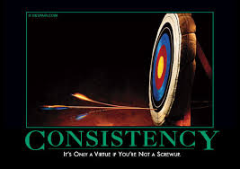
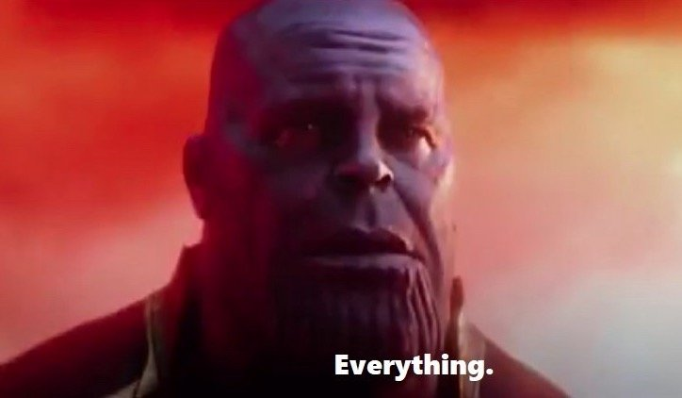
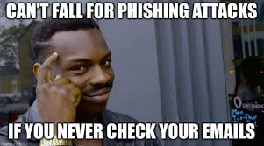
Scope Management Reflection and Next Steps
01 Consistent look all over
02 Store more user data
03 Lock Learning Modules
04 More Advanced
Notes:
Thoughtful paragraph defining scope and its importance (2)
As I move forward with this project I believe it is important to have more clear and specific goals. To start I had very broad goals. I am pleased with where this project is heading. However, going forward I want to be more specific. Some specific goals I have going forward include: (A) Have consistent look to each page of the website. This includes consistent colors and flow. Consistent aesthetic (colors, styling, font). (B) Be able to store all user data. Right now I have it where I can create an email list and have logins. It would be cool to store where each user left off (create levels with it). (C) Be able to lock the learning modules so you have to complete them one by one. (D) Get up to about 9 learning modules which will feature more advanced cybersecurity content. Those are the initial next steps I can think of.
Insightful discussion of scope creep and its impact (3)
Scope creep is real. Initially, I wanted to have everything done and ready to launch for this prototype. However, there is a learning curve that comes with doing something new. On the learning curve you have to adjust and try again. Draft, re-draft, re-draft, etc.. Time has also been limited. It’s been a busy semester. Usually when I sit down to work on this I want at least an hour at a time. 30 minutes here and there is not enough.

Slide 23
APPENDIX
Learn Cybersecurity: “Lexi’s Cyber Club”
Notes:
Add photo of Carson

Slide 24
Sources for beautifying
GITHUB PAGE WITH *MOST*
UPDATES
https://getbootstrap.com/
https://www.sliderrevolution.com/resources/css-cards/
https://materializecss.com/
https://github.com/alexisbernt/Cyber-Capstone-2025

Slide 25
Demo Video
Notes:
Demonstration Video
High-quality demonstration video showcasing the project (5)
Video includes comprehensive overview of all project aspects (3)
Professional editing and production quality (2)

